Slide 1
FIFA PLAYER PERFORMANCE ANALYSIS AND GOAL PREDICTION SYSTEM
Prudhvi Krishna Gangavarapu
Master’s Project
Advisor: Michael Jonas
Information Technology
University of New Hampshire, Manchester

Slide 2
Goal
Comprehensive Data Analysis: Utilize exploratory data analysis techniques to gain insights into football events data, identifying patterns, trends, and factors influencing game outcomes.
Accurate Goal Prediction: Develop machine learning models capable of accurately predicting goal outcomes based on various features from the dataset, such as time, side, assist method, location, fast break, body part, and situation.
Interactive Web Platform: Integrate the findings and models into a user-friendly web application, allowing football enthusiasts to explore and analyze football event data interactively, gaining insights into goal-scoring dynamics and facilitating strategic decision-making in professional football.

Slide 3
Approach
Leverage Technologies: Utilize Exploratory Data Analysis, Machine Learning, and Web Development to analyze football events data.
EDA Techniques: Explore and visualize the dataset to identify patterns, trends, and key factors influencing football game outcomes.
Predictive Modeling: Employ Machine Learning algorithms to predict goal outcomes using match data like time, side, assist method, and more.
Web Application Integration: Develop a Flask-based interactive platform to enable users to explore and analyze football event data effectively.

Slide 4
Data Analysis
Data Verification: Confirmed the Football Events dataset was accurately labeled, ensuring a solid foundation for analysis.
Data Cleaning: Utilized Excel to remove N/A values from the 22 MB dataset, preparing it for detailed Exploratory Data Analysis.
Analysis Tools: Employed Python, Jupyter Notebook, and libraries like Seaborn, NumPy, and Pandas for data manipulation and visualization.
Insight Extraction: Conducted a comprehensive EDA to identify goal-scoring trends, player performances, and test hypotheses using summary statistics and graphs.

Slide 5
Machine Learning
Data Preparation: Filtered the dataset to focus on goal-scoring opportunities, selected key features, and encoded categorical variables for machine learning readiness.
Model Training: Chose Gradient Boosting Classifier and Logistic Regression for their robustness and suitability for binary classification of football goal outcomes.
Model Evaluation: Implemented a Soft Voting Classifier to combine model predictions, enhancing accuracy, and evaluated all models using accuracy score metrics.
Model Validation and Deployment: Utilized k-fold cross-validation for robust validation and serialized the best-performing model for integration into web applications.

Slide 6
Website development
Flask Framework : Employed Flask’s lightweight and modular capabilities to handle HTTP requests and render dynamic content for an interactive user experience.
Web Design with HTML, CSS, and Bootstrap: Structured web pages using HTML, styled with CSS, and enhanced responsiveness with Bootstrap components for a visually appealing interface.
Data and Model Integration: Incorporated data analysis visualizations and machine learning model predictions to provide interactive insights and real-time football event predictions.

Slide 7
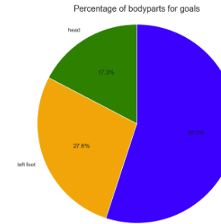
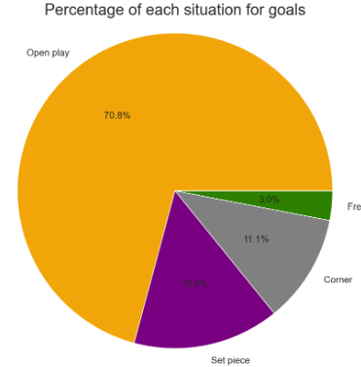
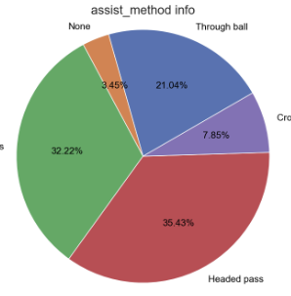
Results
Data Analysis

Slide 8
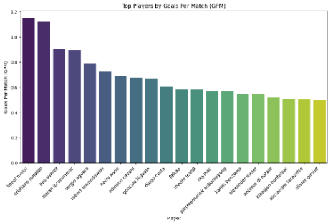
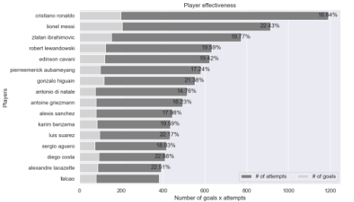
Results
Data Analysis

Slide 9
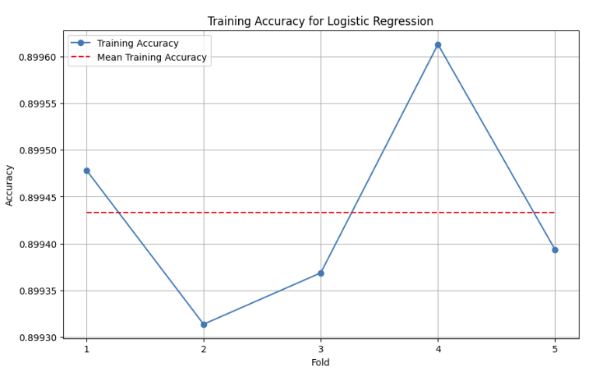
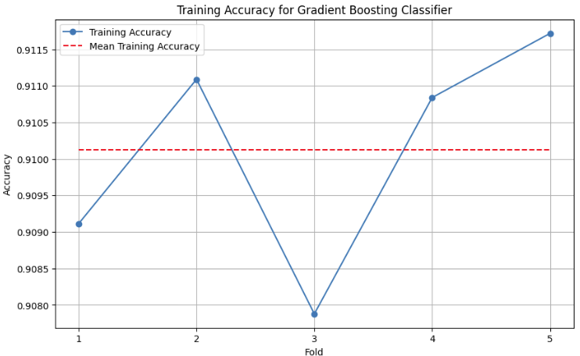
Results
Machine learning
Accuracy for GBC: 91.7%
Accuracy for LR: 89.9%
Accuracy for Soft voting classification: 90.4%

Slide 10
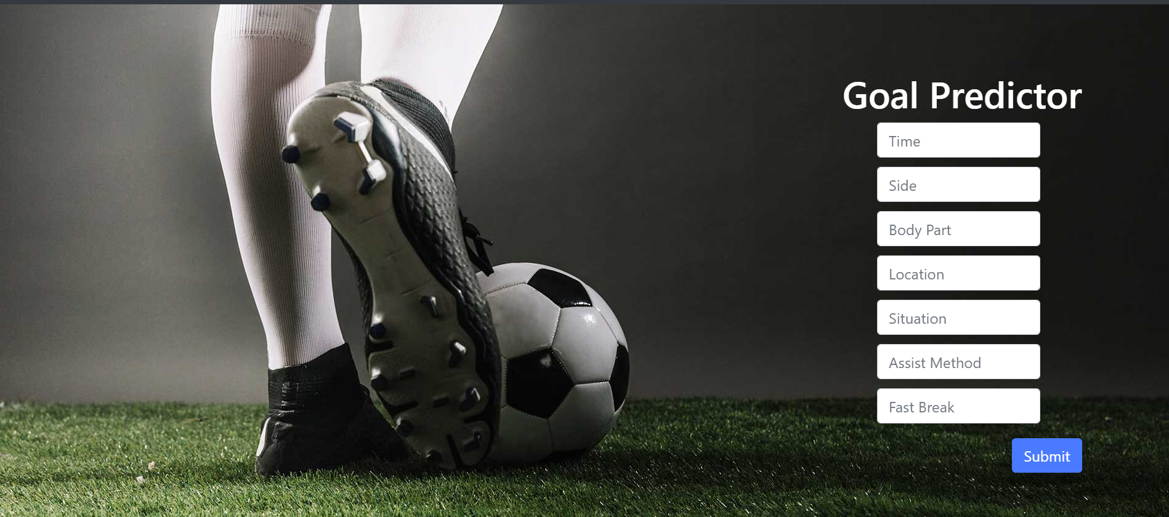
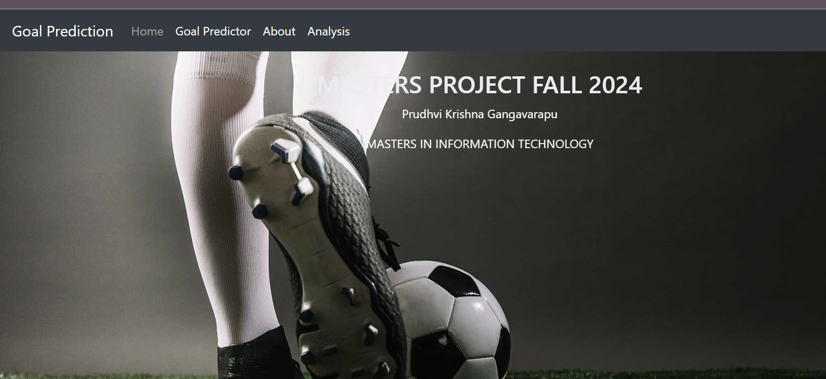
Results
Website

Slide 11

Conclusion
Deep Insights: Achieved a profound understanding of goal-scoring dynamics in football through extensive data analysis and machine learning.
High Accuracy: Attained an impressive 91.7% accuracy with machine learning models, proving their efficacy in predicting football match goal outcomes.
Strategic Impact: Demonstrated the potential of these models to significantly enhance strategic decision-making in the professional football arena.

Slide 12

Thank You

